Slide 1
Publication and related biases
Daniel Acuña
26-02-14

Slide 2
Outline
What is it?
Statistical significance, sample size, hypothesis support and publication
Evidence for publication bias:
Due to failure to publish
Because effect size influences the visibility of published studies
Due to selective reporting of results within a study
Active data suppression
Dealing with publication bias→ Indirect tests:
Funnel plots
Effect size and sample size relationship
Trim and Fill
Fail-safe or file drawer number
Selection models
Misidentification of publication bias
Biased sampling of the natural world

Slide 3
What it is?
“The inaccurate representation of the merit of a hypothesis or idea”
“Published literature reports that systematically differ from those of all studies and statistical test conducted”

Slide 4
Operational definition
Whenever the dissemination of research is such that the effect size included in a meta-analysis generate different conclusions than those obtained if effect sizes for all the appropriate statistical tests that have been correctly conducted were included in the analysis
Notes:
Takes into account that inclusion of individual studies in a meta-analysis ultimately depends on access of info (dissemination bias?). → publish vs unpublished = locate almost every publish study vs modest proportion of the unpublished ones
*difference between genuine unpublished data & research that is publicly available but diff. to locate or retrieve
Some considerations
time lag ‘til pub.
journal→ impact factor of it
country
LANGUAGE
Failure to report some results
Publication bias should NOT be equated with failure of a meta-analysis to locate every available study → still, we will never know if we found every study related to the topic.
Are the effect size used in a meta-analysis a representative sample of those that could potentially be obtained from all the tests that should have been conducted from complete studies?
Apply:
Direct tests (compares published & unpublished) indirect (distribution of published to estimate unpublished)conclude that:
Effect sizes→ Tend to be larger in published analysis hence publication!
comparison of effect sizes between publish & unpublished → no difference
Some types of questions are more biased than others: i.e. nonsignificant results based on small sample size (mammals) vs large (insects) = smaller report effect size in mammals. Sample size <-> weigth

Slide 5
Statistical significance, sample size, hypothesis support & publication
The “problem” with the P-value:
Researchers value significant results more highly than those that fail to reject a null hypothesis → Positive & negative values.
Notes:
Values such as P=0.08 and P=0.80 are treated as being in greater agreement than those where P=0.04 and P= 0.08
Studies with significant results are more likely to be published.
In fields where theory is generally assumed to explain phenomena successfully (physics) it might be even more difficult to publish results that reject null hypotheses → seen as healthy confirmation on the strength of the underlying theoretical framework
Despite this, Biologist always hope that their statistical test will yield significant results
it’s well known that studies with significant results, if methodologically sound, can be published regardless of sample size.
Normally nonsignificant results → inconclusive because low statistical power or genuine absence of a meaningful effect.
Power is a function of sample size, the true effect size and its variance hence nonsignificant results are less likely to be published

Slide 6
Evidence of publication bias

Slide 7
Claim: failure to publish
Csada et al. claimed that 91.4% of studies reported a significant result for the main hypothesis. However, the study lacked a null hypothesis…
Inspection of tables of effect sizes and sample sizes in recent biological meta-analyses suggest that a value of 91.4% is way too high
Bauchau (1997) pointed out that “biologists are notorious to for testing null hypothesis that they expect to reject, rather than designing less readily refutable null hypothesis”

Slide 8
Evidence
The discrepancy might have arisen because biological studies are often written up as a narrative to emphasize a particular significant result. The main hypothesis then becomes the one that generated this result!
The trend in most studies is that published studies have more data that unpublished
Evidence has shown that one factor that pushes a research to be unpublished is its failure to reject the null hypothesis
FDA manipulation

Slide 9
Claim: Effect size influences the visibility of published studies
Studies with significant results are more likely to be published in journals with higher impact factor.
Non-English journals contain a greater proportion of nonsignificant results.
Notes:
These publication patterns create bias through a dissemination effect because papers in these journals are less likely to be found for meta-analysis.
Results that support a prevailing hypothesis were published in higher impact journals than those that rejected it.
If no link between citation frequency and p-value = no publication bias
Cite several confirmatory papers that reject the null hypothesis followed by one that failed to do so.

Slide 10
Evidence
These publication patterns create bias through a dissemination effect because papers in these journals are less likely to be found for meta-analysis.
Results that support a prevailing hypothesis were published in higher impact journals than those that rejected it.
If no link between citation frequency and p-value = no publication bias
Cite several confirmatory papers that reject the null hypothesis followed by one that failed to do so.

Slide 11
…due to selective reporting of results
The way results are written can itself be biased
Only effects sizes for some of the tested predictor variables are presented & reported
Poor presentation of results for nonsignificant findings

Slide 12
Active data suppression
Suppress studies that produce undesirable results.
Can be achieve by manipulating dissemination process
Prohibiting researchers from making public comments on certain studies

Slide 13
Dealing with publication bias: Indirect tests
Considerations:
None of the indirect tests is conclusive
Often applied in ecological meta-analyses to the entire data set where an overall mean is being estimated.
No test for publication bias designed for meta-analyses that use structural models to explain or explore heterogeneity
Notes:
Heterogeneity should be taken into account. Modify before applying

Slide 14
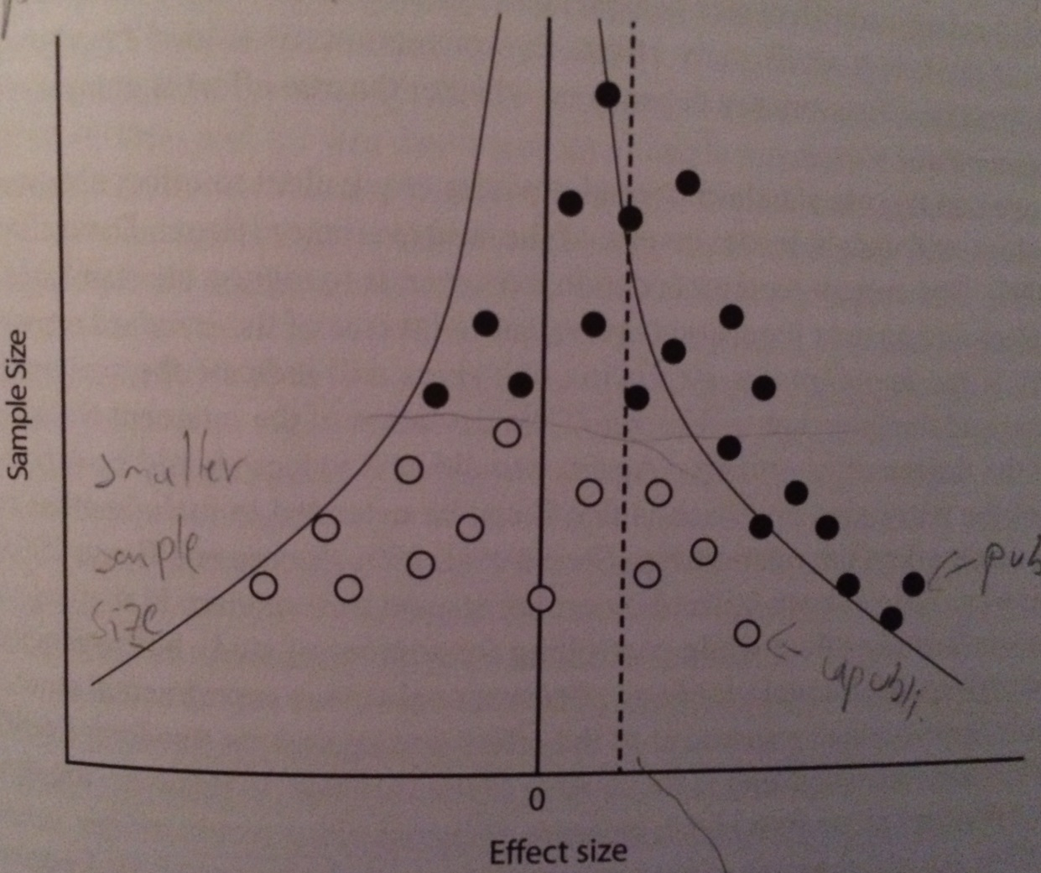
Funnel plot
A visual tool to asses gaps .
Only recommended to aid interpretation
Unpublished studies
Published studies
Unpublished studies
True effect size
Notes:
Variability and range of effect size estimates decrease as sample size increases due to smaller sampling error
When we find a relationship between sample size and effect size, we cannot assign a causal mechanism to it without further investigation.
It is possible that Effect sizes really are larger in smaller studies (because use of diff protocols)
The net outcome in this test is:
asymmetric distribution of published effect sizes
relationship between sample size and effect size
an overestimate of the true effect size
Assume publication bias when asymmetry is such that the effect sizes on the side closest to the null hypothesis values are missing → Lower rate of publication of studies with nonsignificant values.

Slide 15
Relationship between effect size and sample size
2 main statistical tests for funnel plot asymmetry:
Calculate the nonparametric correlation (Kendall or Spearman) between the standardized effect size (E*) and the sampling variance size (n) or standard error (SE) of the study
This should stabilize variances so that a plot of standardized effect size against standard error is not funnel shaped
Notes:
To standardize an effect size: Mean-effect size/sqrt(Variance-∑(inverse of all studies)
Two sided P values are reported because the direction if the asymmetry depends on whether the true effect is greater or less than the null hypothesis

Slide 17
Regress standard normal deviates against P-value and weight by the inverse of the study variance (current recommendation is to regress against precision (inverse of standard error)
If funnel plot is symmetric, slope will indicate size and direction of the effect size and the intercept will be zero.
The deviation of the intercept of zero provides an index of the degree of asymmetry . Two sided P values are reported as well

Slide 18
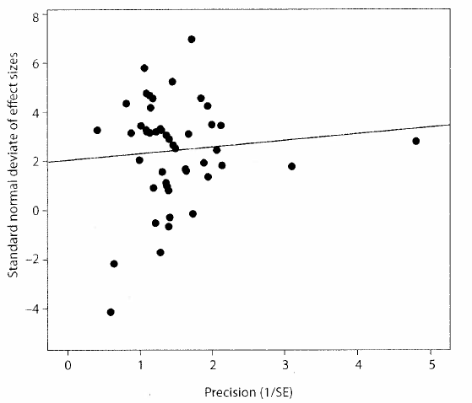
Leas Squares regression

Slide 19
Will usually assume publication bias when asymmetry is such that the effect sizes on the side closest to the null hypothesis values are missing → Lower rate of publication of studies with nonsignificant values.

Slide 20
Trim and fill
A form of sensitivity analysis rather than a method to estimate the actual size effect sizes of unpublished studies
Computationally simple method to adjust for funnel plot asymmetry.
Allows to enter values for missing studies to generate a symmetric funnel plot from which a new mean effect size can be estimated
Assumes that studies with more extreme values on the left side of the funnel plot are those that will be missing to publication bias.
Notes:
Trim off the most extreme values from the right side of the plot until it’s symmetric

Slide 21
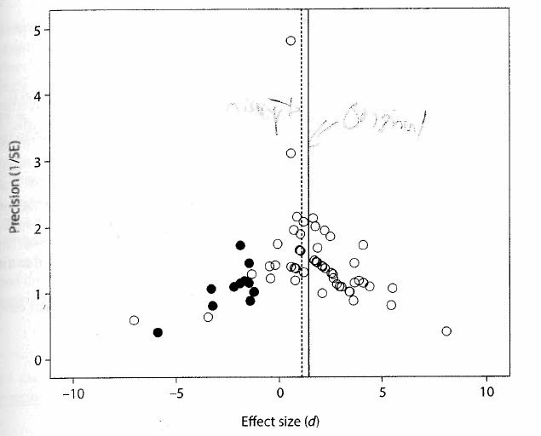
Based on Curtis and Wang data
Missing
Original

Slide 22
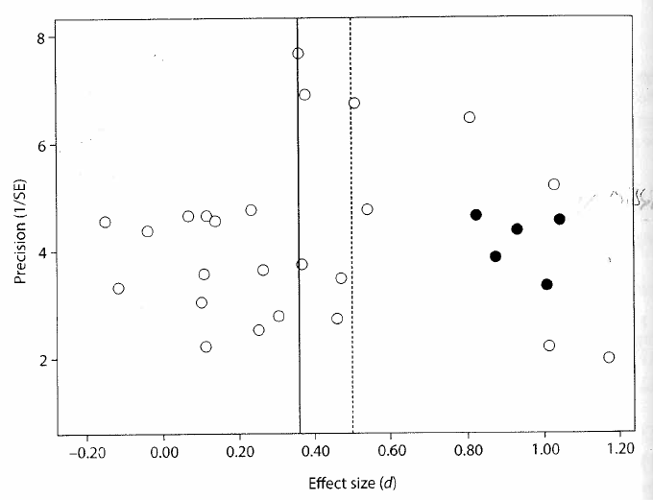
Based on Torres-Vila and Jennions
Missing
Larger
Original

Slide 23
Fail-safe or file drawer number
Not based on funnel plot asymmetry
It tries to answer “how many studies (N) averaging an effect size of zero that were not located would need to exist to negate the significance of an observed effect size or to reduce it to a specific minimal value?
A significant meta-analytic result is robust if N>5k+10
Notes:
=null hyp
K= # of studies already in a meta analysis

Slide 24
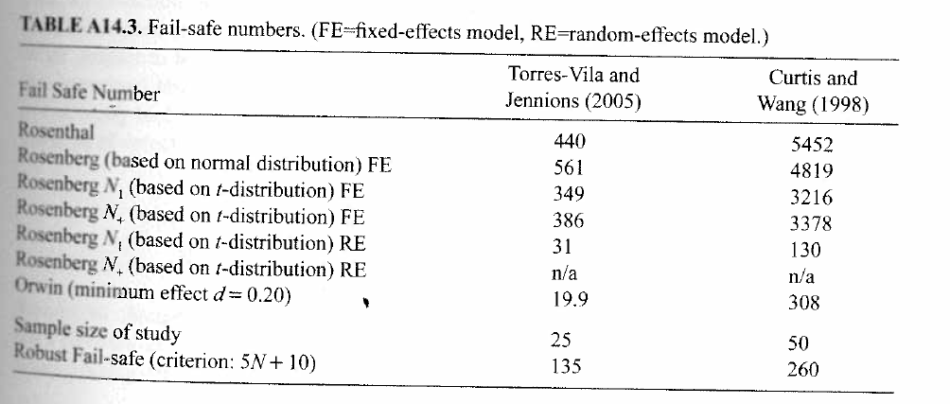
Developed by Rosenberg

Slide 25
Selection models
Divided into those where the selection criteria that weight the likelihood of publication are either base:
separately on the effect size and its standard error
Solely on P-values
Notes:
The model provides a weighting reflecting the likelihood that a given result is published
An effect size model then states expected distribution of effect size in the absence of publication bias
Difference between predicted and observed distribution of effect sizes is attributed to publication bias

Slide 26
Misidentification of publication bias
Reasons for funnel plot asymmetry with a small-study effect
Study heterogeneity can generate asymmetry but cannot by itself provide a general explanation for a “small-study” effect.
Combining experimental and observational studies
Heterogeneity in baseline values
Continuous sampling and early termination of some studies
Taxa or system related heterogeneity
Study quality
Sample size and measurement error
Incorrect transformation of effect sizes
Actual publication bias against nonsignificant results

Slide 27
Biased sampling of the natural world
Northern temperate rather than tropical species
Birds & mammals instead of insects or fish
Animals that are easily captured or marked
Species that occur at high rather than low densities
Species of economic or agricultural interest
Species that seem most likely to yield more interesting results.
Notes:
Some systems are better studied than others therefore, caution when making statements about effect sizes in the natural world.
Random samples?
Conclusions restricted to the artificial world of “species tend to be studied

